Slide 1
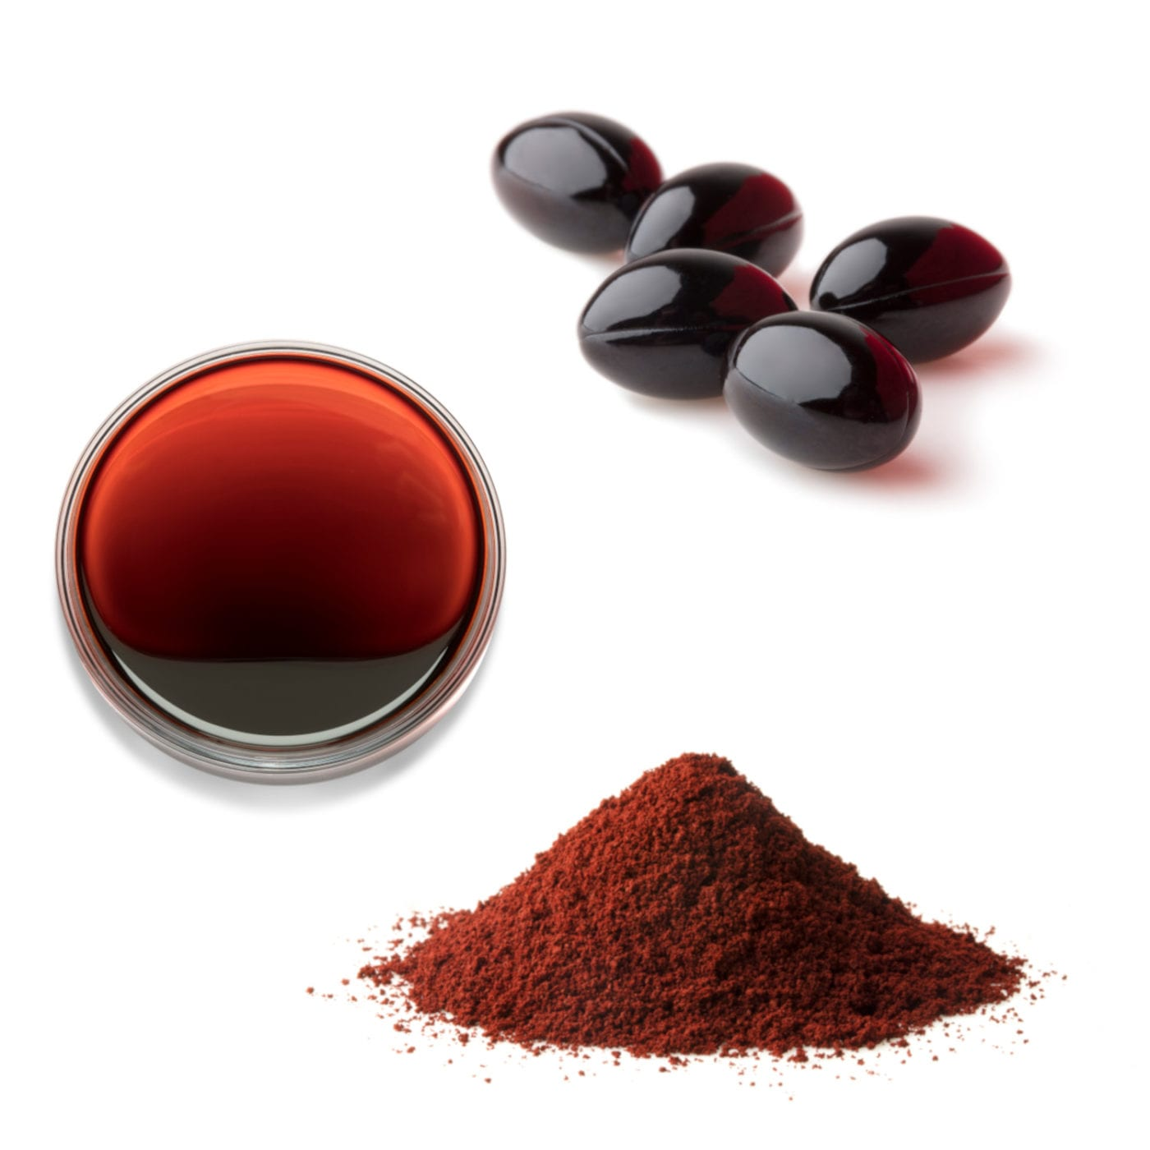
Astaxanthin
Commercial production by large scale cultivation of green algae ‘‘Haematococcus pluvialis’’

Slide 2
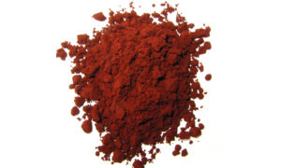
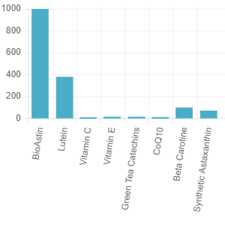
What is Astaxanthin?
Astaxanthin is a member of Xanthophyll family of carotenoids and is ubiquitous in fresh/saltwater
Astaxanthin, also known as the King of Carotenoids®, is one of nature’s most powerful antioxidants that has been documented in over 200 scientific studies including over 50 human clinical trials to show a wide range of benefits including:
  Immune Health
  Eye Health
  Skin Health during UV/Sun Exposure
  Joint Health
  Cardiovascular Health
  Healthy Inflammatory Response
  Recovery from Exercise

Slide 3
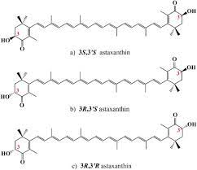
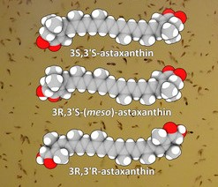
Astaxanthin: Natural Vs. Synthetic
Synthetic astaxanthin is produced from petrochemical sources, which raises the issues of food safety (potential toxicity in the final product)
Synthetic Astaxanthin is a mixture of three isomers, namely (3S,3’S), (3R,3’S) and (3R,3’R) with proportion ratio of 1:2:1 respectively, and is not esterified on its hydroxyl groups.
Astaxanthin from microalgae is exclusively (3S,3’S) or (3R,3’R) isomers and mostly esterified by fatty acids.
Therefore, the chemical synthetic Astaxanthin is only allowed to be used in aquaculture, not allowed for human consumption and animal feed other than aquaculture applications.

Slide 4






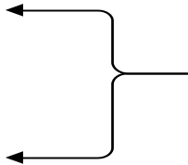



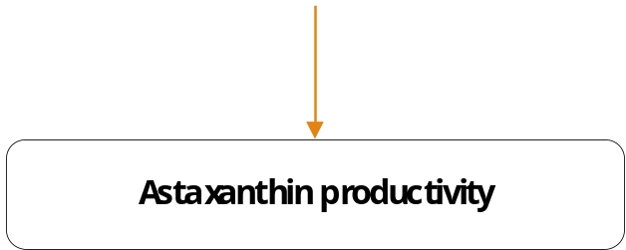


Project Methodology:

Slide 5
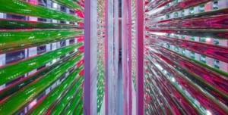
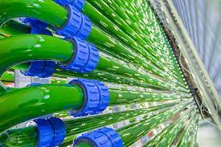
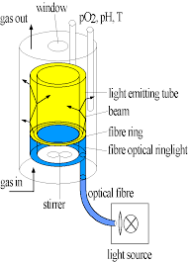
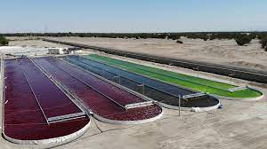
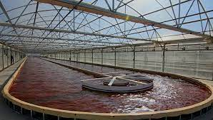
A. Cultivation phase:
(hybrid culture system), which consists of tubular photobioreactors fence “PBR” (producing green biomass under optimal growth conditions ‘’green stage’’) and complex of open raceway ponds (inducing Astaxanthin accumulation by exposing algal cells into stress environmental conditions ‘’red stage’’)
Green stage (motile vegetative stage):
in which the microalgae cells continuously divide and proliferate, synthesizing chlorophyll. During this stage full nutrient medium and moderate light intensity, temperature and pH are required.
Red stage (non-motile resting stage):
in which cell division stops and chlorophyll levels don’t fluctuate, resulting in a continuous increase of Astaxanthin content and cellular dry weight.
The inhibition of cell proliferation and the accumulation of Astaxanthin are triggered, when microalgal cells experience nutrient starvation. Further adverse environmental conditions involve high light intensity, high temperature and salt stress.

Slide 6
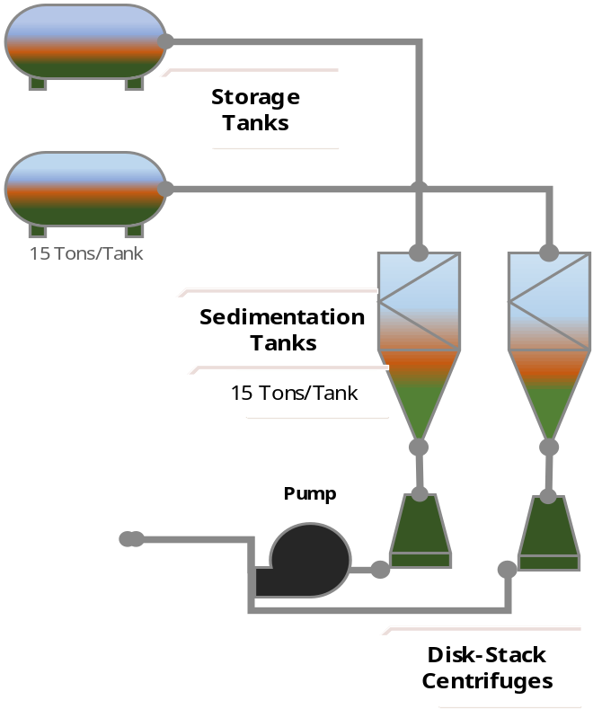
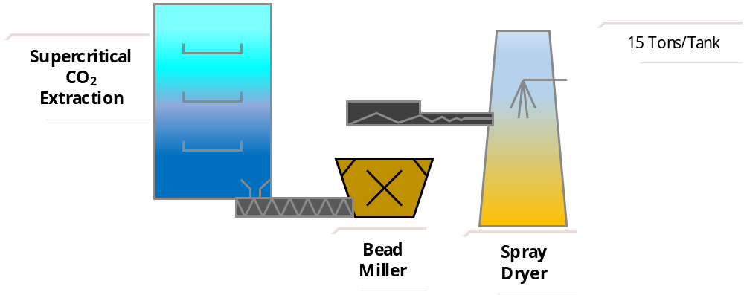
B. Harvesting phase:
Harvesting of algal biomass constitute a critical part within the production line, since it usually represents 20-30% of the production costs. High harvesting costs are due to various algal features that make harvesting of algal biomass difficult:
Low microalgae cell densities in the broth.
The small size of most algal cells.
The negatively charged algal suspension.
The fast growth rates of microalgae, which require frequent harvesting compared to terrestrial plants.
C. Extraction phase:
Extraction phase divided into three processes:
Cell disruption.
Dehydration.
Recovery of the desired metabolite.

